Slide 1
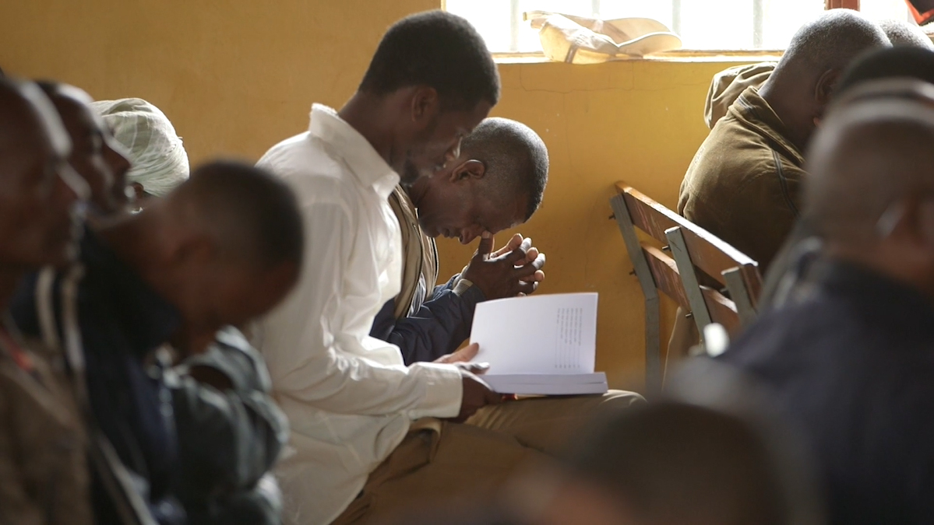
Statement of Faith

Slide 2
?
What do you think of when I say the word
“value”?
When we talk about “values,” we mean
the beliefs that define and guide the way we live.

Slide 3

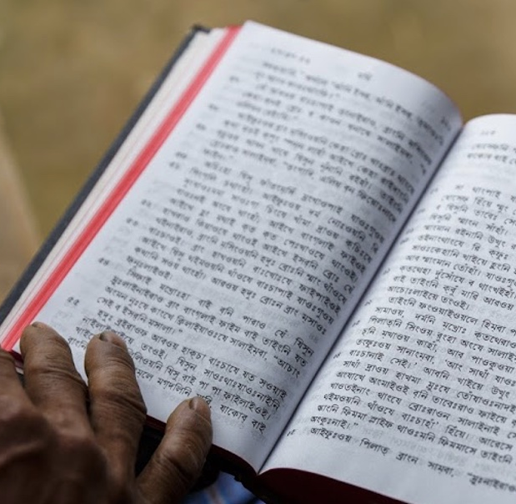
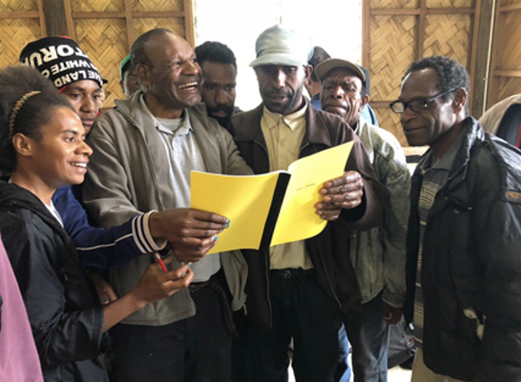
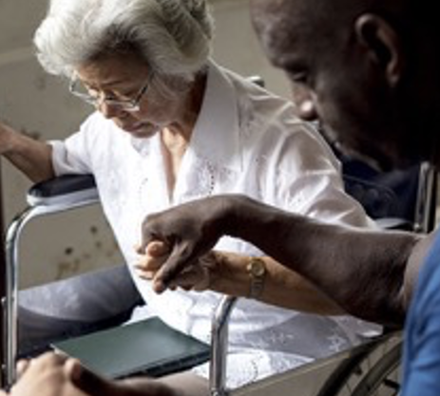
We believe that the Bible is the Word of God.
We believe that the Bible changes lives and advances God’s kingdom.
We believe in the power of the Holy Spirit in the lives of believers.

Slide 4
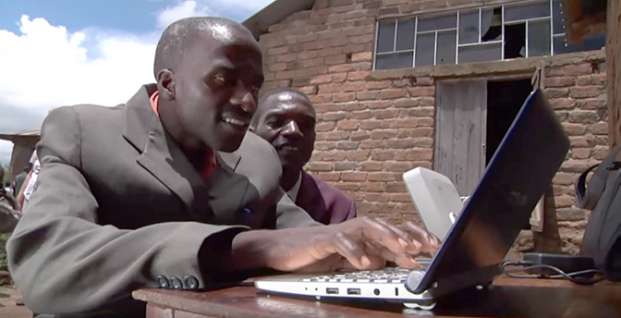
VISION:
A Bible in every language
MISSION:
Involving people
in the advancement of Bible translation

Slide 5
?
How does that vision and mission connect with our values?

Slide 6
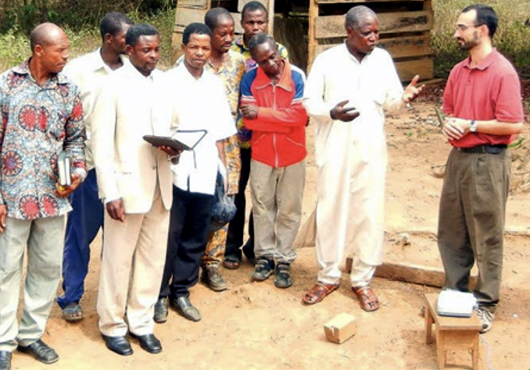
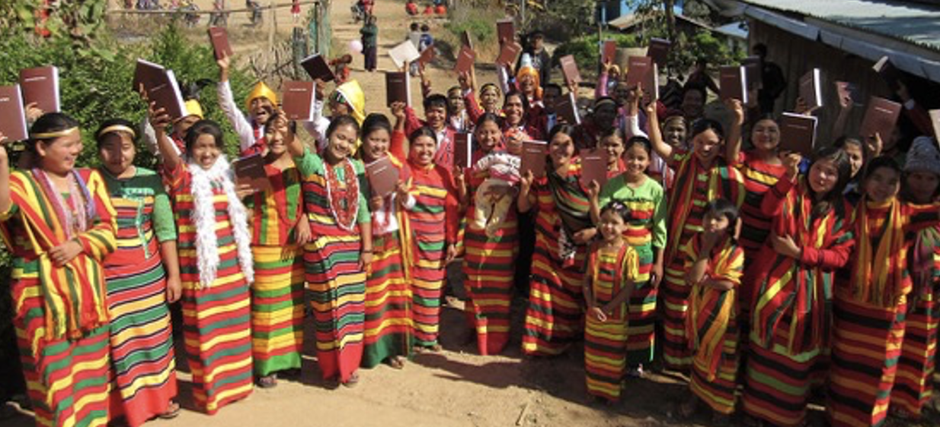
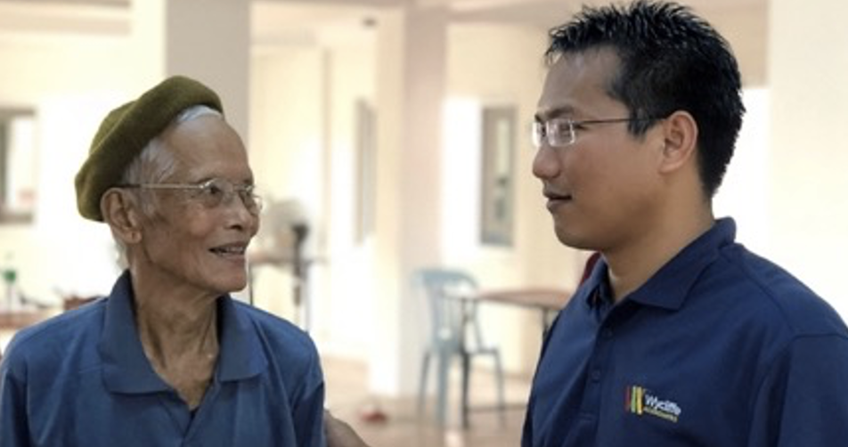
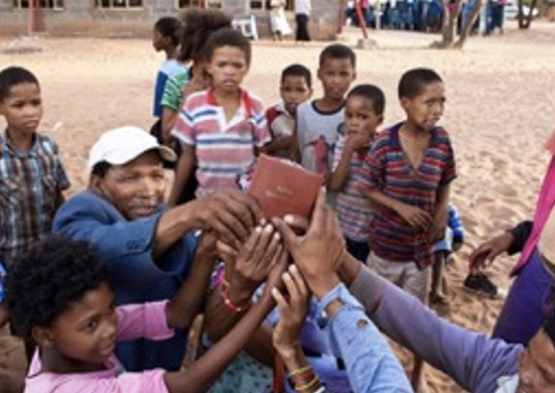
Every Language

Slide 7
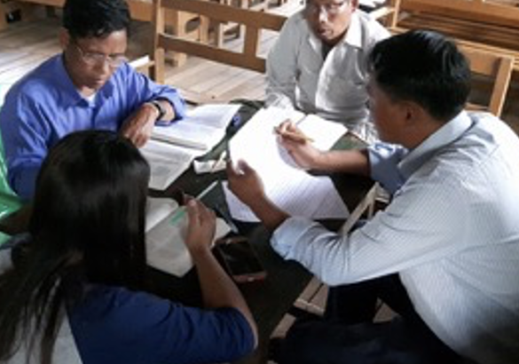
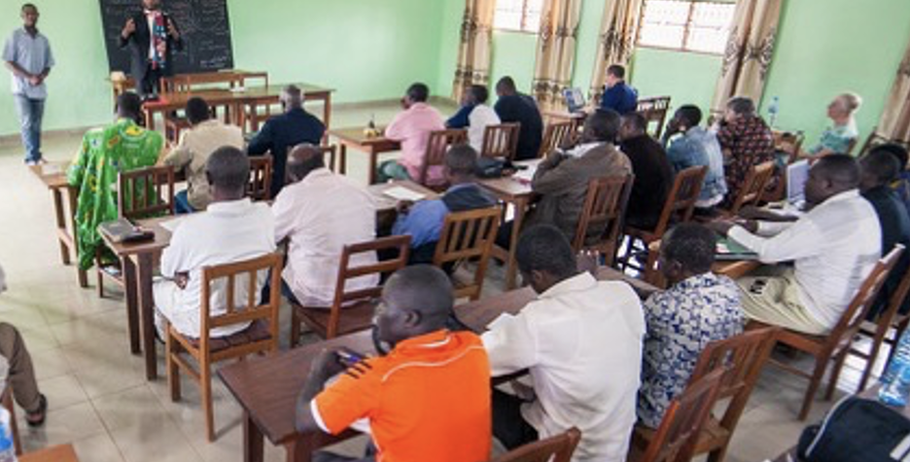
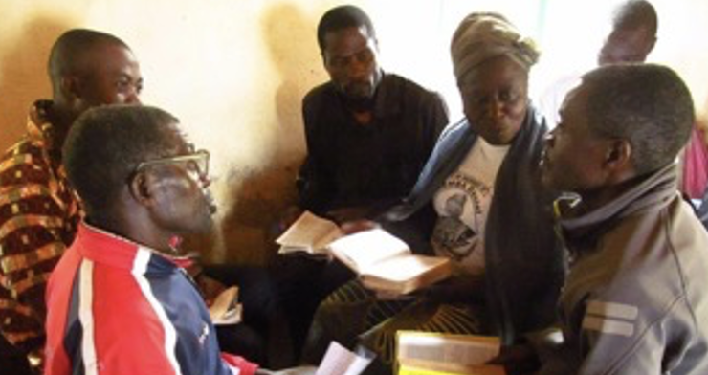
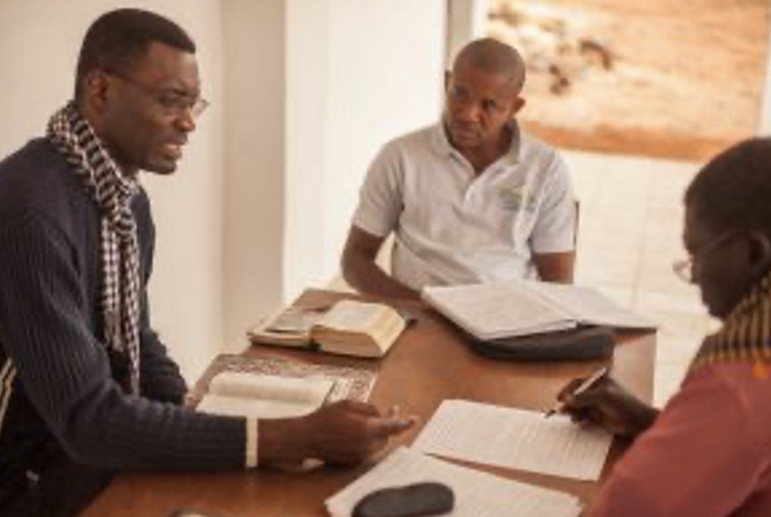
The whole Body of Christ

Slide 8


Core Beliefs
Statement
of Faith

Slide 9
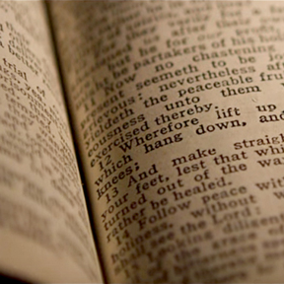
Statement
of Faith
Primary Beliefs

Slide 10

Varied
non-primary beliefs are
OK
Example:
baptism by immersion or by sprinkling

Slide 11
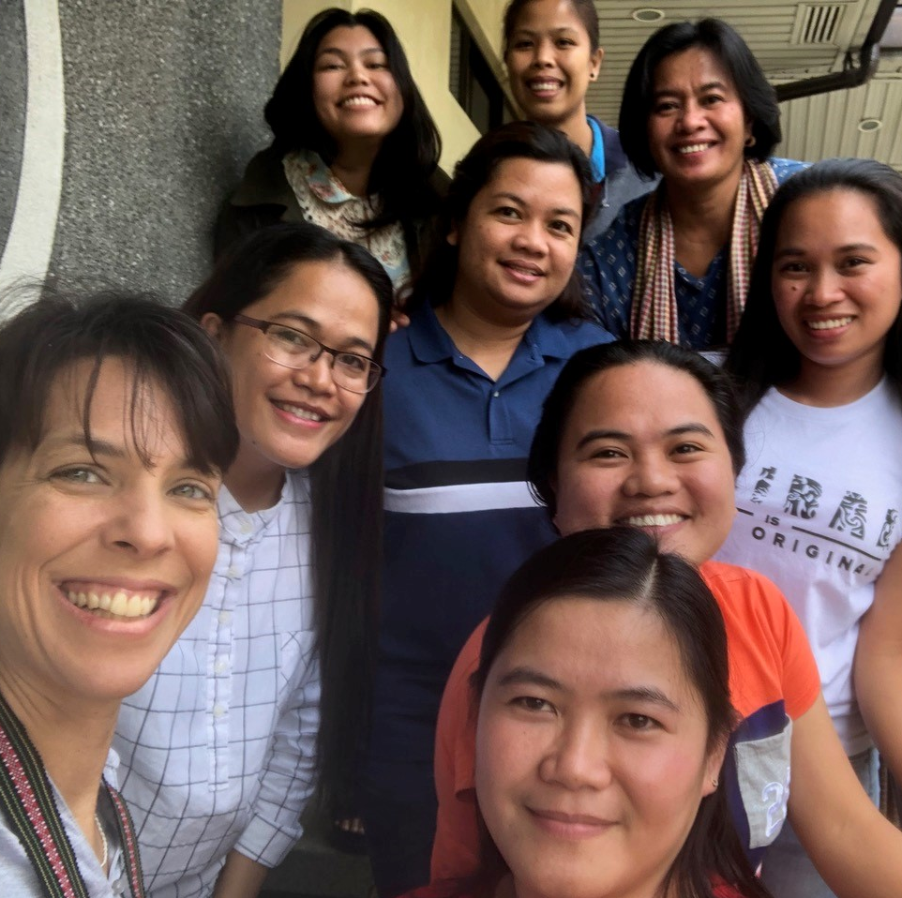
Statement
of Faith
encourages:
unity
what is
most
important
a
foundation
for working
together

Slide 12
1. We affirm the divine inspiration and consequent authority of the Scriptures for faith and practice.
2. We affirm that there is one God, eternally existing in three persons: Father, Son, and Holy Spirit.
3. We affirm the fall of man, the consequent moral depravity and sinfulness of all humanity, God’s righteous judgment against sin, and every person’s need for salvation by God’s grace through Jesus Christ.
4. We affirm that Jesus Christ died as a substitute for sinners, bearing the death they deserved, and that God raised him from the dead.
5. We affirm that salvation is God’s gracious gift, received through faith in Jesus Christ.
6. We affirm that the Lord Jesus Christ will return personally in glory and judge the world.
7. We affirm the bodily resurrection of all people, the saved to eternal life and the lost to eternal punishment.

